Slide 1



DNS Falsification and the Threatening of Online Security

Slide 2
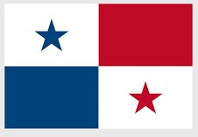
ICANN76- NEXTGEN
Yaiza González from Panama
Student of Law and Political Sciences at Universidad Interamericana de Panama
Research Assistant at Instituto Panamericano de Derecho y Nuevas Tecnologias (IPANDETEC )

Slide 3
DIGITAL SECURITY IN LATIN AMERICA
Pishing attacks in Latin America
Brasil 6th
Panama 51st
Guatemala 61st
Mexico 71st
Chile 48th
Ecuador 8th
Peru 33rd
Colombia 37th
Paraguay 65th

Slide 4
WHAT IS SEGURAS EN LINEA?
Seguras en linea
URL: ( www.segurasenlinea.ca). This web site aims to visualize the digital violence in Central America and Dominican Republic

Slide 5
OUR OBJETIVE
Help people who are affected through digital media.
It is essential to achieve online security through DNS protection.

Slide 6
WHAT CAN YOU FIND IN SEGURAS EN LINEA?
Digital violence
Guides to report platforms
Report to the governmental authorities
Basic tips about online security
Interesting resources of other organizations
Associations
A blog to share contributions of the topic.

Slide 7
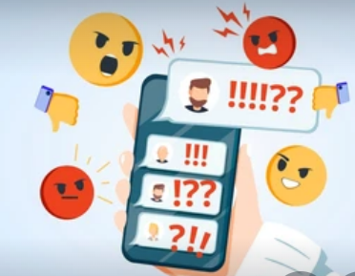
COMMON CYBER-CRIMES
Cyberbullying
Human trafficking
The inadequate use of data or digital identity
Phising
Pharming

Slide 8
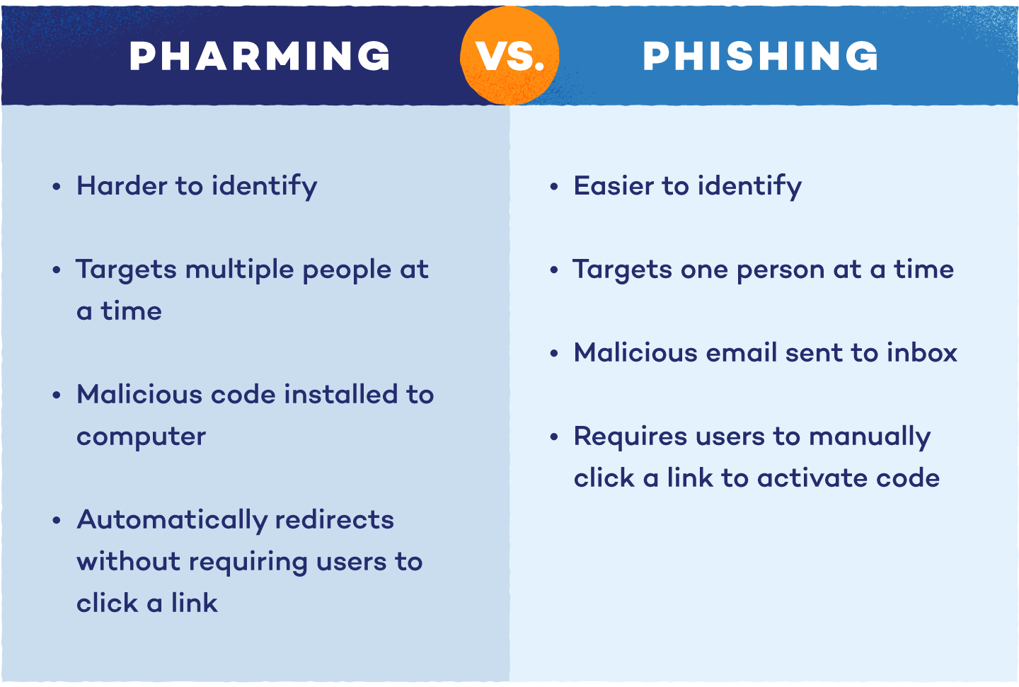

Slide 9
CONCLUSION
It is important to implement a system to enjoy safe connections in internet. They must include service protection and safety DNS because it is not enough to protect our DNS services ourselves, it is necessary to have external security to avoid the vulnerability of our personal information.

Slide 10


@ipandetec
http://www.ipandetec.org/

